Slide 1
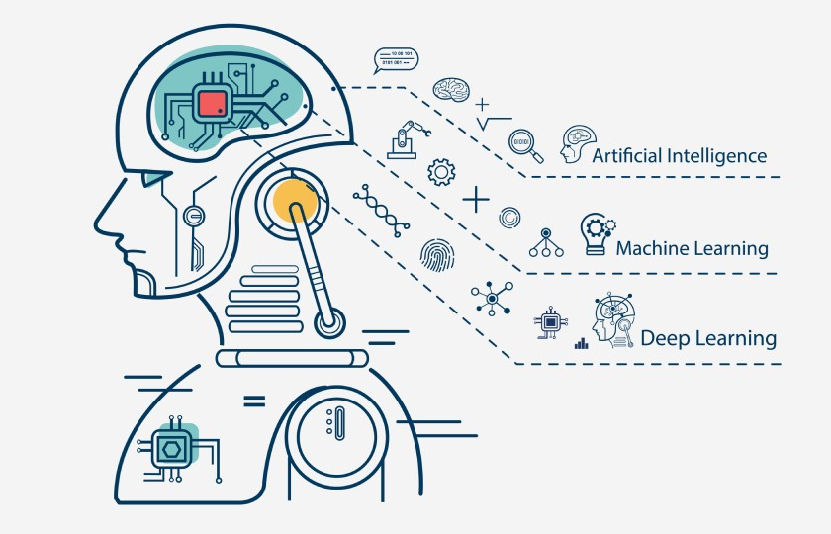
What is Deep Learning

Slide 2

Deep learning is a subset of machine learning, which is essentially a neural network with three or more layers. These neural networks attempt to simulate the behavior of the human brain—albeit far from matching its ability—allowing it to “learn” from large amounts of data. While a neural network with a single layer can still make approximate predictions, additional hidden layers can help to optimize and refine for accuracy.

Slide 3

Deep learning drives many artificial intelligence (AI) applications and services that improve automation, performing analytical and physical tasks without human intervention. Deep learning technology lies behind everyday products and services (such as digital assistants, voice-enabled TV remotes, and credit card fraud detection) as well as emerging technologies (such as self-driving cars).

Slide 4

Deep Learning vs Machine Learning
If deep learning is a subset of machine learning, how do they differ? Deep learning distinguishes itself from classical machine learning by the type of data that it works with and the methods in which it learns.
Machine learning algorithms leverage structured, labeled data to make predictions—meaning that specific features are defined from the input data for the model and organized into tables. This doesn’t necessarily mean that it doesn’t use unstructured data; it just means that if it does, it generally goes through some pre-processing to organize it into a structured format.

Slide 5

Deep learning eliminates some of data pre-processing that is typically involved with machine learning. These algorithms can ingest and process unstructured data, like text and images, and it automates feature extraction, removing some of the dependency on human experts. For example, let’s say that we had a set of photos of different pets, and we wanted to categorize by “cat”, “dog”, “hamster”, et cetera. Deep learning algorithms can determine which features (e.g. ears) are most important to distinguish each animal from another. In machine learning, this hierarchy of features is established manually by a human expert.

Slide 6
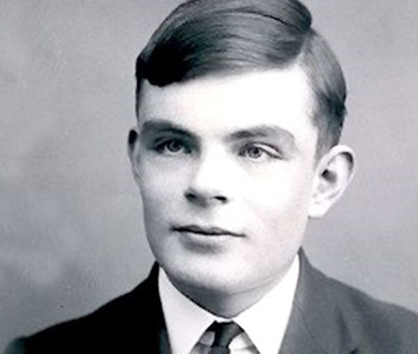
How deep learnings works
Deep learning neural networks, or artificial neural networks, attempts to mimic the human brain through a combination of data inputs, weights, and bias. These elements work together to accurately recognize, classify, and describe objects within the data.

Slide 7
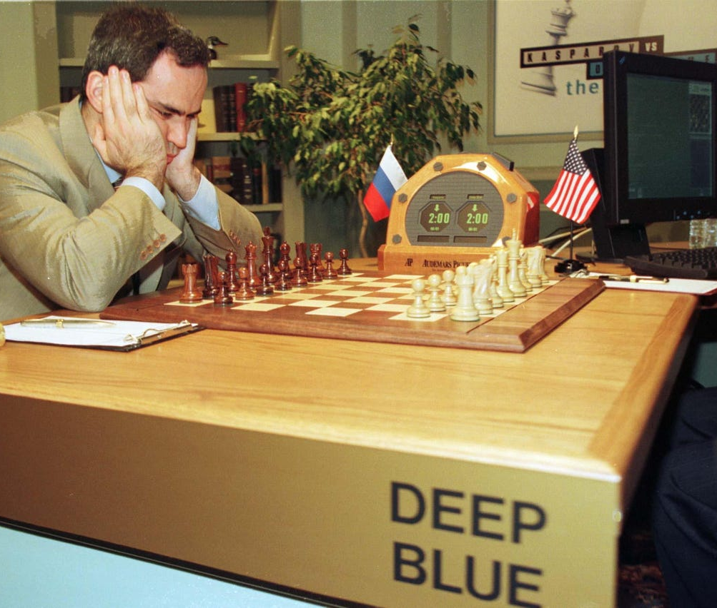
Deep neural networks consist of multiple layers of interconnected nodes, each building upon the previous layer to refine and optimize the prediction or categorization. This progression of computations through the network is called forward propagation. The input and output layers of a deep neural network are called visible layers. The input layer is where the deep learning model ingests the data for processing, and the output layer is where the final prediction or classification is made.

Slide 8
Prepared by
Afife Altınkaya
Cihat Can Rüzgar
Onur Bağcı

Slide 9
References
https://www.ibm.com/cloud/learn/deep-learning
https://www.kaggle.com/learn/intro-to-deep-learning

